Slide 1
Jemez Springs
Propagation Maps

Slide 2
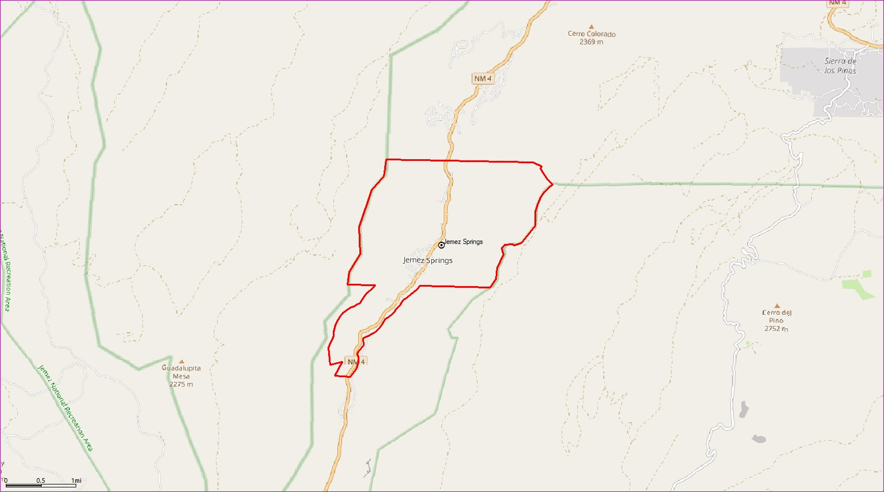
Baseline Map
Coverage Level
In Building
In Car
Outdoor
Scale
0
0.5
1mi

Slide 3
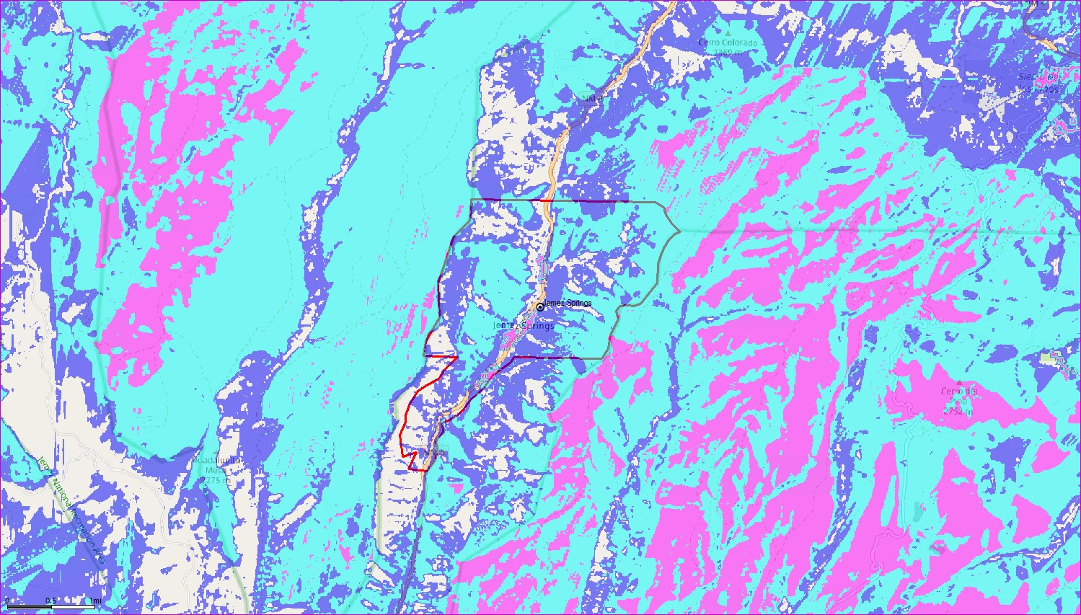
Commnet UMTS – Existing Coverage
Coverage Level
In Building
In Car
Outdoor
Scale
0
0.5
1mi

Slide 4
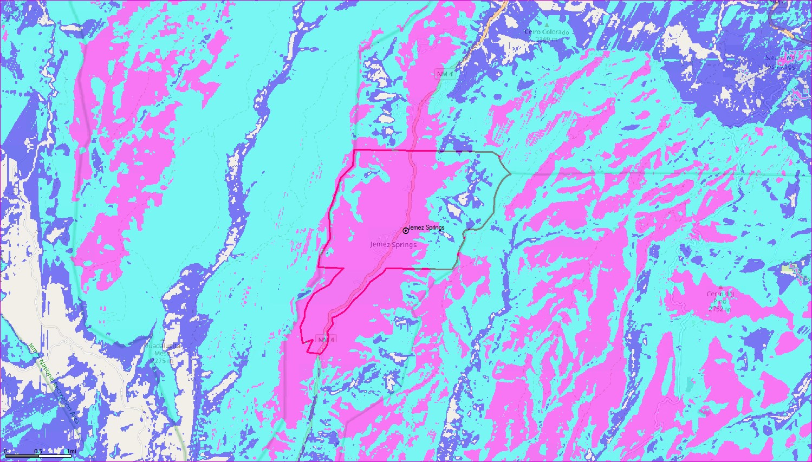
Commnet UMTS – Resulting Coverage at 60’
Coverage Level
In Building
In Car
Outdoor
Scale
0
0.5
1mi

Slide 5
Commnet UMTS – Resulting Coverage at 50’
Coverage Level
In Building
In Car
Outdoor
Scale
0
0.5
1mi

Slide 6
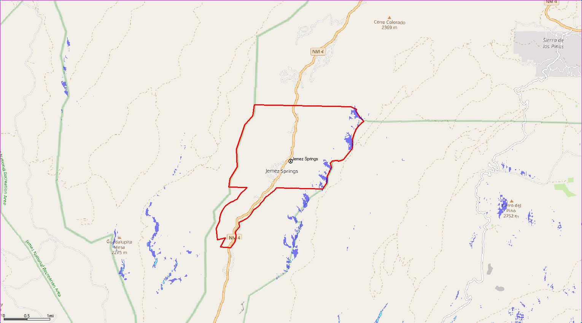
AT&T FirstNet– Existing Coverage
Coverage Level
In Building
In Car
Outdoor
Scale
0
0.5
1mi

Slide 7
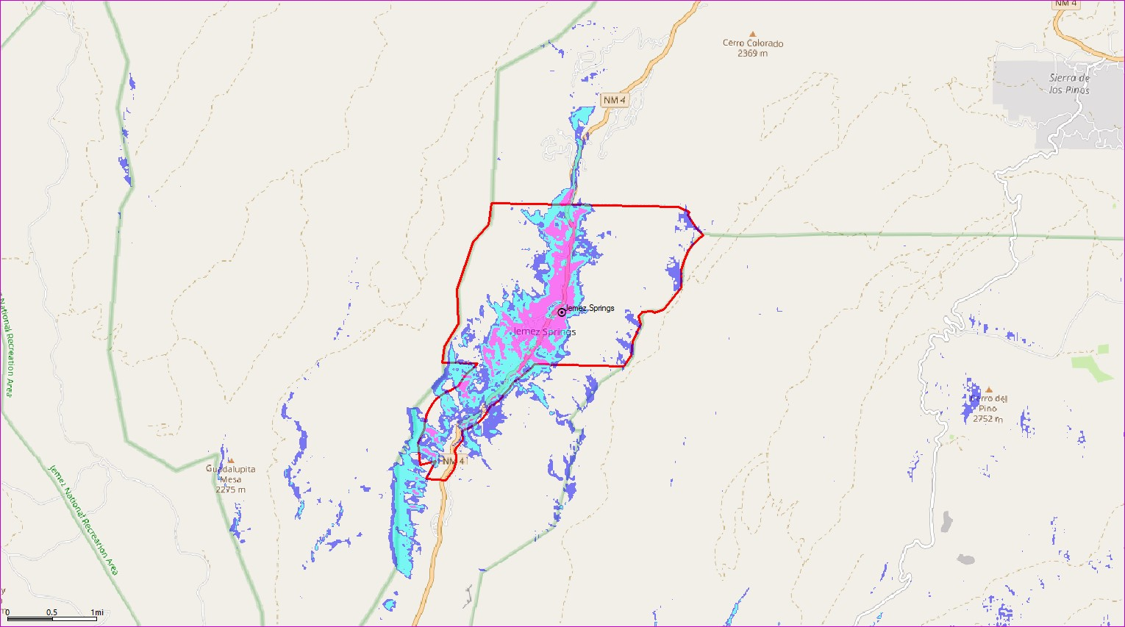
AT&T FirstNet – Resulting Coverage at 48’
Coverage Level
In Building
In Car
Outdoor
Scale
0
0.5
1mi

Slide 8
AT&T FirstNet – Resulting Coverage at 38’
Coverage Level
In Building
In Car
Outdoor
Scale
0
0.5
1mi

Slide 9
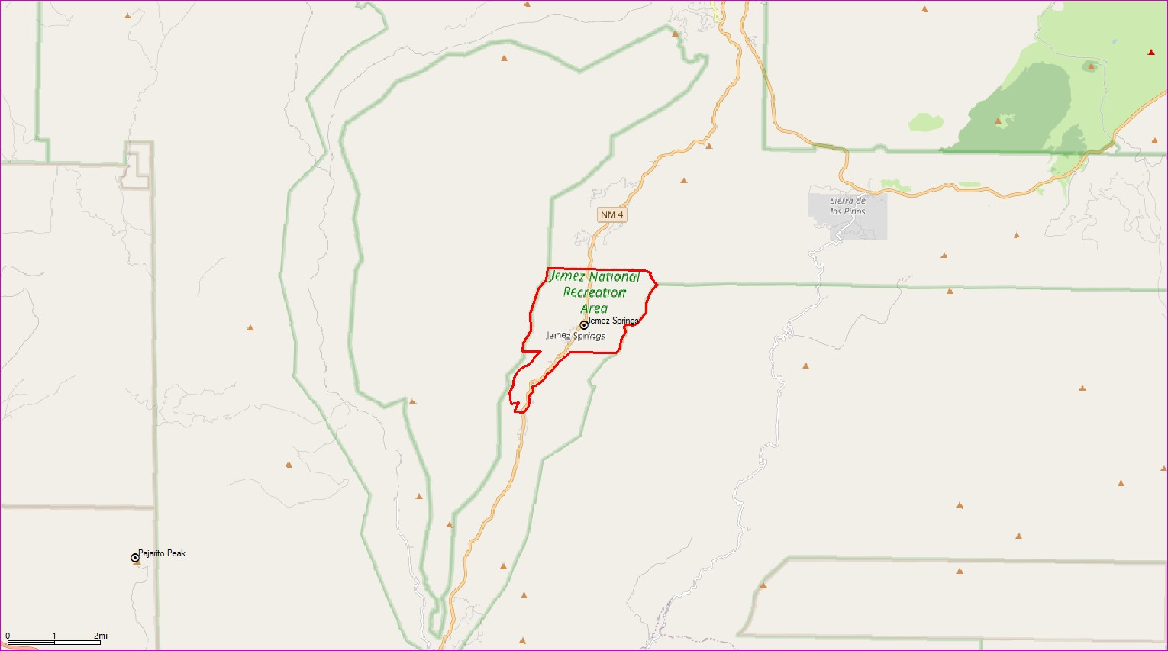
Baseline Map
Coverage Level
In Building
In Car
Outdoor
Scale
0
1
2mi

Slide 10
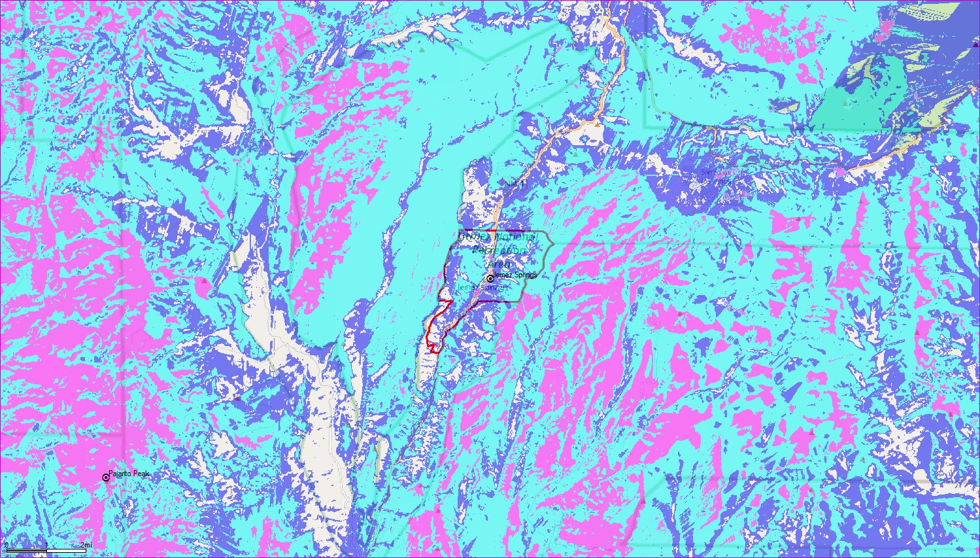
Commnet UMTS – Existing Coverage
Coverage Level
In Building
In Car
Outdoor
Scale
0
1
2mi

Slide 11
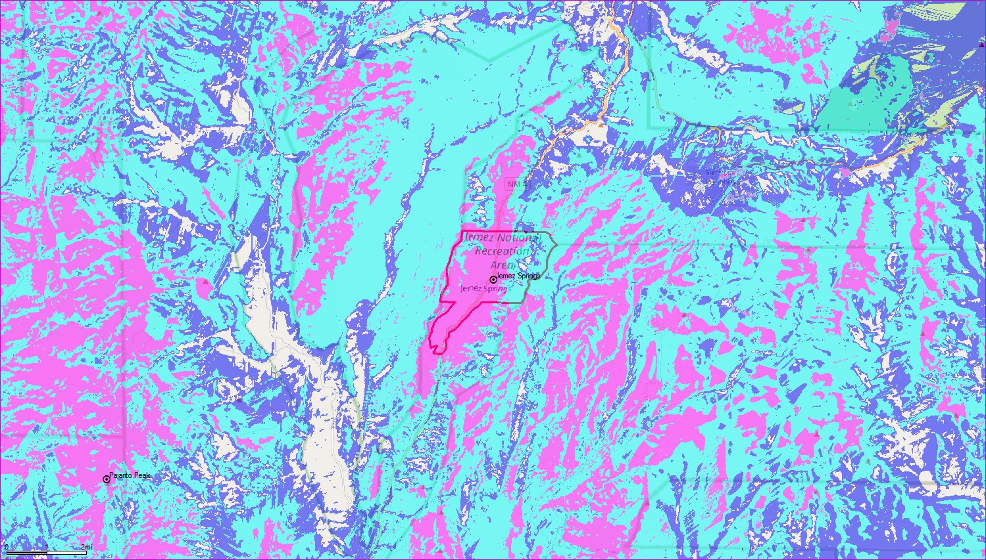
Commnet UMTS – Resulting Coverage at 60’
Coverage Level
In Building
In Car
Outdoor
Scale
0
1
2mi

Slide 12
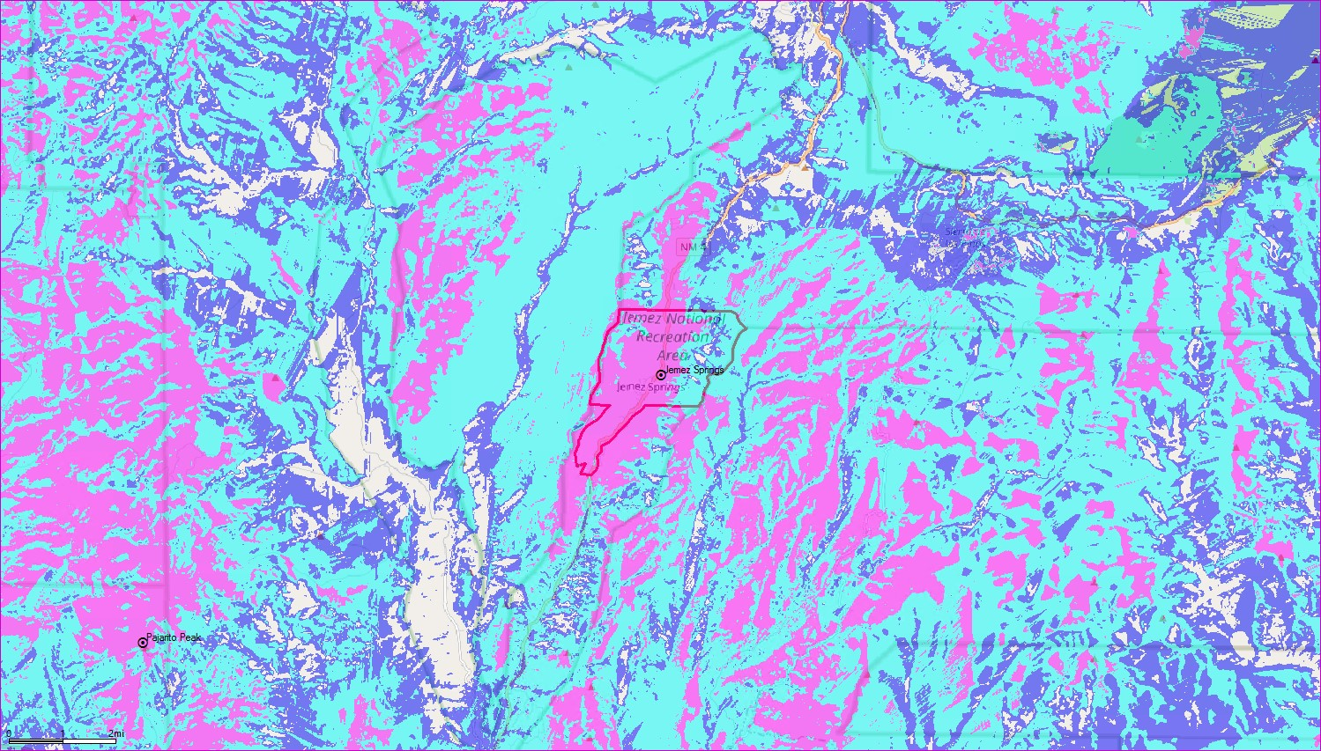
Commnet UMTS – Resulting Coverage at 50’
Coverage Level
In Building
In Car
Outdoor
Scale
0
1
2mi

Slide 13
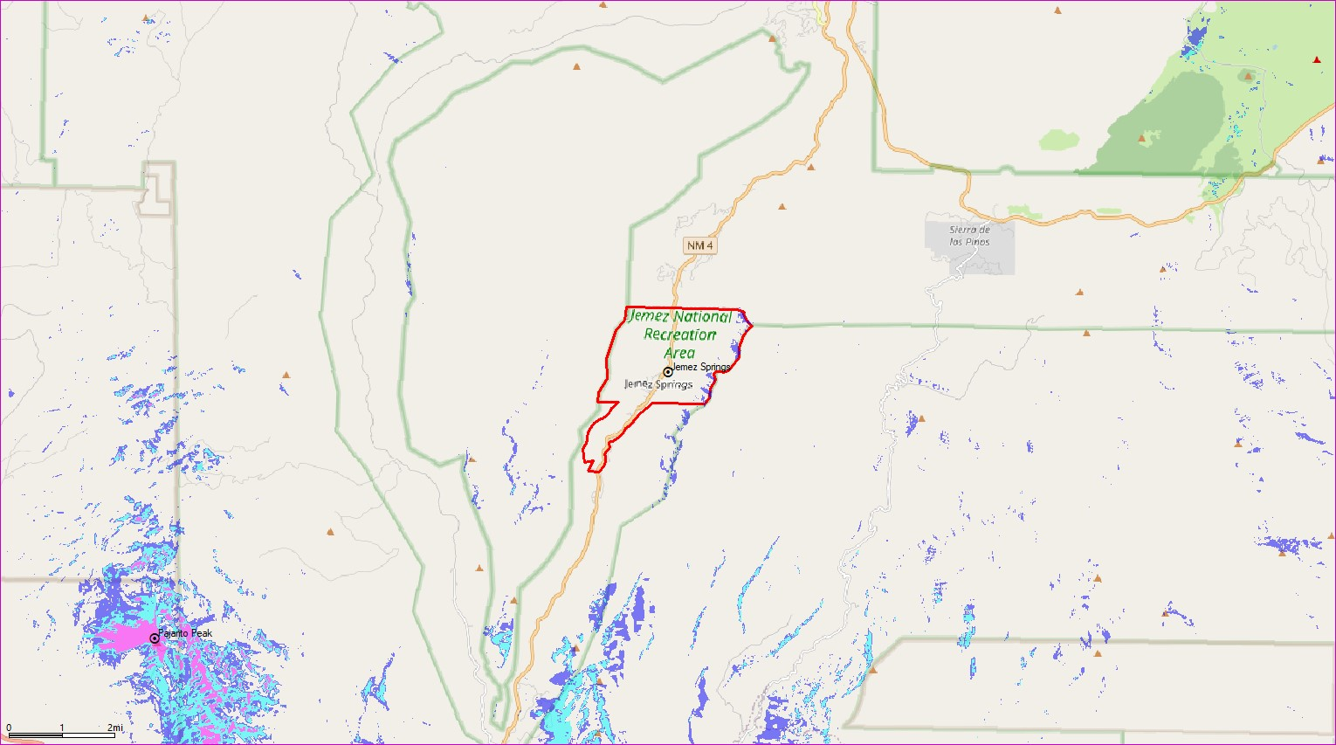
AT&T FirstNet– Existing Coverage
Coverage Level
In Building
In Car
Outdoor
Scale
0
1
2mi

Slide 14
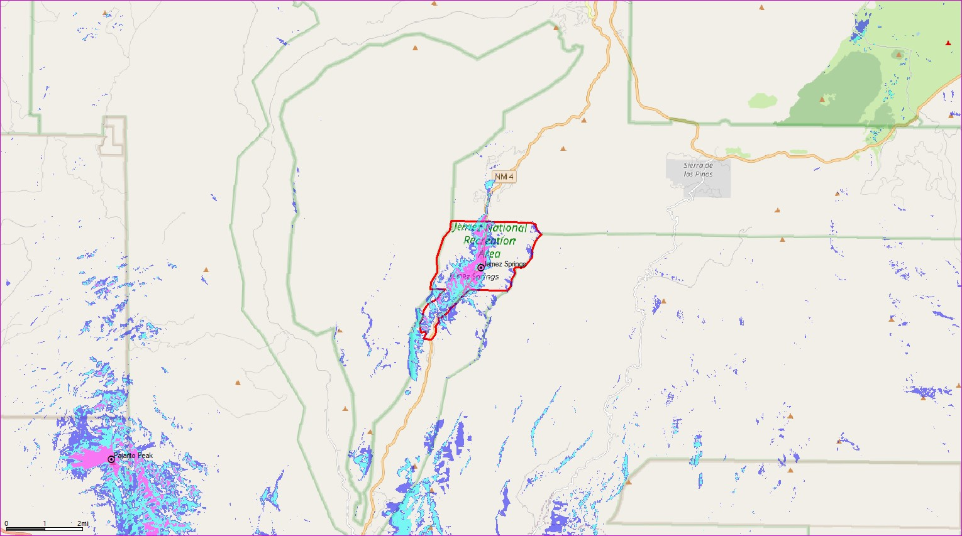
AT&T FirstNet – Resulting Coverage at 48’
Coverage Level
In Building
In Car
Outdoor
Scale
0
1
2mi

Slide 15
AT&T FirstNet – Resulting Coverage at 38’
Coverage Level
In Building
In Car
Outdoor
Scale
0
1
2mi

